Slide 1
Introduction to C

Slide 2
History:
It was developed by Dennis Ritchie in 1972 at Bell Laboratories of AT&T(American Telephone and Telegraph) Lab.
It was developed for UNIX operating system.
Before C the following languages are used, ALGOL, BCPL and B.
Definition:
C is a general-purpose, procedural, mid-level programming language
It used in system programming and application programming like development of computer software and applications, games, web development and more.
There are only 32 keywords in C.

Slide 3
Procedural oriented programming(POP)-
It based on instruction or procedure based.
Can divide the program into much smaller programs called functions.
It follow top-down approach.
Mid-level language:
It have features of both low level and high level language.
Features:
Simplicity and Efficiency:
Simple Syntax , so it is easy to learn.
Fast speed:
Fast
It has compiler.
It is statically typed programming language.

Slide 4
Portable:
Write once and run it anywhere.
Memory Management:
Less memory management.
Pointers:
Access the memory.
It initialize as an array, variables etc.
Structured Language:
Program can be divided into small parts using functions and stored it in libraries for reusability.

Slide 5
Preprocessor:
Preprocessor director starts with #.
Gives the model instruction that the processor understand.
The C preprocessor executes before a program is compiled.
The preprocessor accepts the source code as input and is responsible for removing comments.
For Example:
#include<math.h>→standard library maths files
#include<stdio.h>→standard library I/O file
#define—defines a symbolic name or constant
#define MAX_ARRAY_SIZE 100

Slide 6
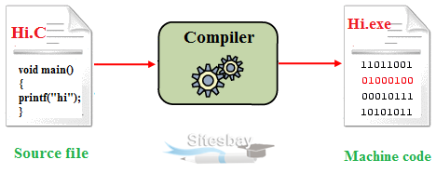
Compiler
It is a software that converts the source code into the object code.
Assembler:
It is a software that converts Assembly language into machine code.

Slide 7
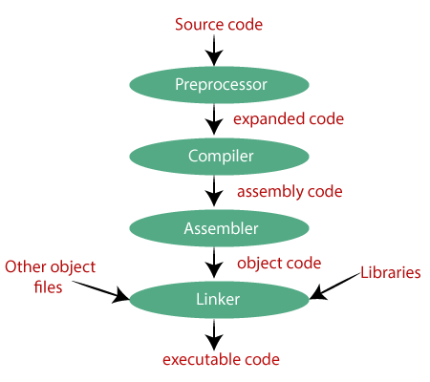

Slide 8
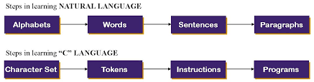
Basic of C Program:

Slide 9
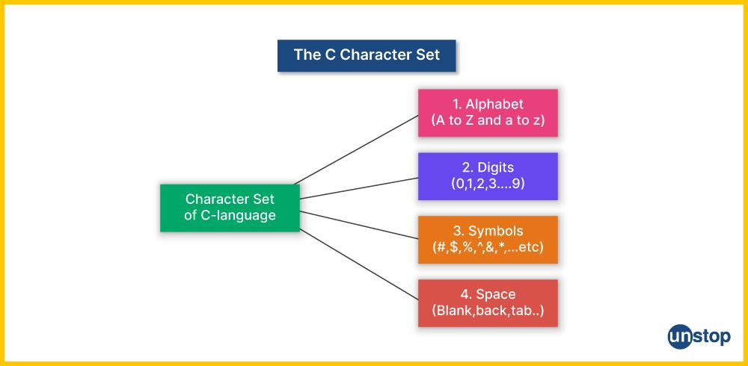
Character Set of C:

Slide 10
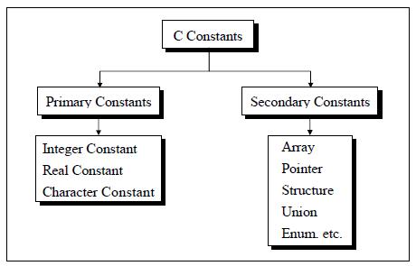
‘C’ constants:
A constant is an entity that never change.
There are two types of C constants
Primary Constants
Secondary Constants

Slide 11
Integer Constants:
It is the numbers that come under these categories,
Decimal (Base 10), Octal (Base 8), Hexadecimal (Base 16)
Rules for constructing Integer constants
An integer constant must have at least one digit.
It must not have a decimal point.
It can either be positive or negative.
If no sign precedes an integer constant, it is assumed to be positive.
No commas or blanks are allowed within an integer constant.
For example,
1, 45, -56, +678

Slide 12
Rules for constructing Real/Float constants in Fractional Form:
A real constant must have at least one digit after point.
It must have a decimal point
It could be either positive or negative
If no sign precedes an float constant, it is assumed to be positive.
No commas or blanks are allowed within a real constant.
For example:
+56.5554, –56.455, 5655.5557

Slide 13
Rules for constructing Character constants:
A character constant is a single alphabet, a single digit or a single special symbol enclosed within single quotes.
The maximum length of a character constant is 1 character.
For Example:
‘A’, ‘f’, ‘4’
Rules for constructing String constants:
String constants are enclosed within double quotes.
For Example:
“Welcome to Networkz Systems”, “Good to see you”, “learning is fun”.
“45”,”##$%^”

Slide 14
Basic structure of C program:
#include<stdio.h>
int main()
{
printf("Hi, hello");
return 0;
}
# include → preproccesser instruction
stdio.h (standared input output) → header file
int main() → main function and start of the program
{ }→ scope of the program
Output:
Hi, hello

Slide 15
VARIABLES AND EXPRESSION
Chapter 2

Slide 16
Variables:
A variable is a container to store data(values).
Variable names are names given to the memory locations.
These location can hold integer, real, char or string constants.
The integer variables needs 4bytes, float variable needs 4bytes, double variable needs 8bytes and char variable needs 1byte memory space.
Syntax:
datatype variable_name=value;
Ex:
int c=2;

Slide 17
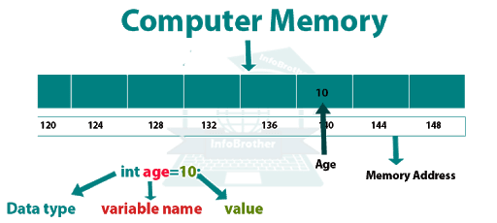

Slide 18
Rules for variable name:
The variable name can be Alpha-numeric.
(eg) no1
But it should start with an alphabets.
It should not contain any spaces in between.
It should not contain any special symbols except underscore(_)in between
(eg) std_name
It should not contain any keyword.
For Example:
int no1,no_2;
float total;
char c;

Slide 19
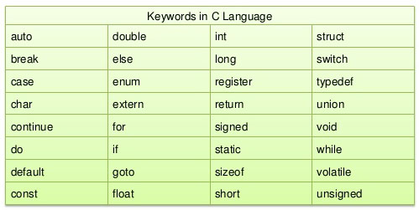
Keywords:
Keywords are predefined, reserved words in C language and each of which is associated with specific features. They have special meaning to the compilers.

Slide 20
Assign the values to the variables at the time of declaration:
%d is format specifier for integer.
%f is format specifier for real.
%c is the format specifier for character.

Slide 21
Program:(declaring and asign the variable to value)
#include<stdio.h>
int main(){
int number1=12;
float number2=50.25;
char ch='A';
printf("Integer value = %d\n",number1);
printf("Float value = %f\n",number2);
printf("Character value = %c\n",ch);
return 0;
}
Output:
Integer value = 12
Float value = 50.250000
Character value = A

Slide 22
IO functions:
printf()->function to display output to the user.
scanf()->function to take input from the user
Example: printf() #include<stdio.h>
int main(){
printf("Hi, hello");
return 0;
}

Slide 23
Pogram: (printf & scanf) #include<stdio.h>
int main(){
int number;
printf("Enter the number : ");
scanf("%d",&number);
printf("Entered number = %d",number);
return 0;
}
Comment:
The program should be properly documented.
Multi line comments: /* */.
Single line comments //.
Output:
Enter the number : 5
Entered number = 5

Slide 24
The single character input/output functions:
getchar ( )→is used to get a single character and require key after input.
Syntax:
datatype variablename=getchar( );
putchar ()-> is used to put a single character on the standard output device.
Syntax:
putchar(variablename);

Slide 25
Program: getchar()
#include<stdio.h>
int main(){
char variable;
printf("Enter character : ");
variable=getchar();
printf("Entered character = %c",variable);
return 0;
}
Output:
Enter character : Hello
Entered character = H

Slide 26
Program : putchar()
Output:
Enter character : World
Entered character = W
#include<stdio.h>
int main(){
char variable;
printf("Enter character : ");
variable=getchar();
printf("Entered character = ");
putchar(variable);
return 0;
}

Slide 27
String input output functions How to Take Input of a String With Spaces in C ?
#include<stdio.h> int main() { char sentence[20]; printf("Enter any sentence: "); scanf("%s", &sentence); printf("You entered: %s.", sentence); return 0; }
Output:
Enter any sentence : Hello World
Entered sentence is Hello
how to handle space also...using gets()... #include<stdio.h>
int main(){
char sentence[30];
printf("Enter any sentence : ");
gets(sentence);
printf("Entered sentence is %s",sentence);
return 0;
}
Output:
Enter any sentence : Hello World
Entered sentence is Hello World

Slide 28
Program:(define string)
#include<stdio.h>
int main(){
char firstname[10];
char lastname[10];
printf("Enter firstname : ");
scanf("%s",&firstname);
printf("Enter lastname : ");
scanf("%s",&lastname);
printf("%s\n",firstname);
printf(“%s\n",lastname);
// printing the input value in the same line with a space using printf()
printf("%s %s",firstname,lastname);
return 0;
}
Output:
Enter firstname : Hello
Enter lastname : World
Hello
World
Hello World

Slide 29
Program: using puts()
#include <stdio.h> int main(){ char f_name[20]; char l_name[20]; printf("Enter your first name: \n"); // take user input fgets(f_name,20,stdin); // use fgets to get input printf("Enter your last name: \n"); // take user input fgets(l_name,20,stdin); // use fgets to get input puts(f_name); // printing the input value using puts() puts(l_name); return 0; }
Output:
Enter your first_name : Hello
Enter your last_name : World
Hello
World

Slide 30
Operators:
Arithmetic Operators
Relational/Comparison Operators
Bitwise Operators
Logical Operators
Assignment Operators
Unary Operators
Arithmetic Operators:
It used to perform simple Arithmetic operations. They are,
+ Addition
- Subtraction
* Multiplication
/ Division
% Modulus

Slide 31
Program: (Arithmetic Operators)
#include<stdio.h>
int main(){
int numberOne,numberTwo;
printf("Enter two numbers : ");
scanf("%d %d",&numberOne,&numberTwo);
printf("Addition of two number is %d\n",(numberOne+numberTwo));
printf("Subtraction of two number is %d\n",(numberOne-numberTwo));
printf("Multiplication of two number is %d\n",(numberOne*numberTwo));
printf("Division of two number is %d\n",(numberOne/numberTwo));
printf("Modulus of two number is %d\n",(numberOne%numberTwo));
return 0; }
Output:
Enter two numbers : 5 2
Addition of two number is 7
Subtraction of two number is 3
Multiplication of two number is 10
Division of two number is 2
Modulus of two number is 1

Slide 32
Assignment Operators:
An Assignment operators are used to assign the values to variables.
They are,
=, +=, -=, *=, /=, %=, &=, |=, ^=
Program:
#include<stdio.h> int main() { int a=10, b=5; int c=a+b; printf("C value is:%d \n",c); c+=a; //c=c+a; c=15+10= 25 printf("C value is:%d \n",c); b-=c; //b=b-c; b=5-25= -20 printf(“B value is:%d \n",b); a*=b; //a=a*b; a=10*-20= -200 printf(“A value is:%d \n",a); return 0; }
Output:
C value is:15
C value is:25
B value is:-20
A value is:-200

Slide 33
Comparison/Relational operator:
Comparison operators are used to compare two values.
The return value of a comparison is either 1(true) or 0(false).
They are,
< Less than
> Greater than
== Equal
!= Not equal
<= Less than or equal
>= Greater than or equal

Slide 34
Program: (Comparison Operator)
#include<stdio.h>
int main(){
int a,b;
printf("Enter two numbers : ");
scanf("%d %d",&a,&b);
printf("Lessthan:%d\n",(a<b));
printf("Greaterthan:%d\n",(a>b));
printf("Lessthan or equal:%d\n",(a<=b));
printf("Greaterthan or equal:%d\n",(a>=b));
printf("Equal to :%d\n",(a==b));
printf("Not equal to :%d\n",(a!=b));
return 0;
}
Output:
Enter two numbers : 3 5
Lessthan:1
Greaterthan:0
Lessthan or equal:1
Greaterthan or equal:0
Equal to :0
Not equal to :1

Slide 35
Bitwise Operators:
It allow access and modification of a particular bit inside a section of the data.
It can be applied to integer types and bytes and can’t to apply float and double.
Operators:
& Binary AND Operator
| Binary OR Operator
^ Binary XOR Operator
~ Binary Complement Operator
<< Binary Left Shift Operator
>> Binary Right Shift Operator

Slide 36
Program: (Bitwise Operator)
#include<stdio.h>
int main(){
int a,b;
printf("Enter two values : ");
scanf("%d %d",&a,&b);
printf("AND value = %d\n",(a&b));
printf("OR value = %d\n",(a|b));
printf("XOR value = %d\n",(a^b));
printf("NOT value = %d\n",(~a));
printf("Rightshift value = %d\n",(a>>2));
printf("Leftshift value = %d\n",(a<<2));
return 0;
}
Output:
Enter two values : 10 4
AND value = 0
OR value = 14
XOR value = 14
NOT value = -11
Rightshift value = 2
Leftshift value = 40

Slide 37
Logical operator:
Logical operators are used to determine the logic between variables or values.
Operators:
&& Logical and
|| Logical or
! Logical not
NOTE: 1’st condition of AND is true, then it move to next
condition, otherwise it false.

Slide 38
Program:(Logical Operator)
#include<stdio.h>
int main(){
int a=10,b=5;
printf("%d\n",(a>b)&&(a<b));
printf("%d\n",(a>b)||(a<b));
printf("%d\n",!((a>b)&&(a<b)));
return 0;
}
Output:
0
1
1

Slide 39
Unary Operators:
It need only one operand .
Used to increment, decrement or negate the values.
Types:
Increment
Decrement
Increment:
It used to increase the values.
Types:
Pre increment (increment and compute)
Post increment (compute and increment)

Slide 40
Program: pre increment
#include<stdio.h>
int main(){
printf("++ preincrement\n");
int a=5;
printf("value of a : %d\n",a);
printf("value of a : %d\n",++a);
printf("value of a : %d\n",a);
return 0;
}
Output:
++ preincrement
value of a : 5
value of a : 6
value of a : 6

Slide 41
Program: post increment
#include<stdio.h>
int main(){
printf("postincrement ++\n");
int a=5;
printf("value of a : %d\n",a);
printf("value of a : %d\n",a++);
printf("value of a : %d\n",a);
return 0;
}
Output:
postincrement ++
value of a : 5
value of a : 5
value of a : 6

Slide 42
Decrement:
It used to decrease the values.
Types:
Pre decrement (decrement and compute)
Post decrement (compute and decrement)

Slide 43
Exercise:
Write a C program to display student details.
Write a C program to find the area of circle.
Write a C program to illustrate the post decrement operator.
Write a C program to illustrate the assignment and conditional operator.

Slide 44
Group:
select shape image want to chage→format→group

